Slide 1
AzME Demo
Nov 09, 2015

Slide 2
http://mcdonalds.cciccat.com/
https://app.capptain.com/#application/mcd000011/monitor/session/total
weiyuqing021@gmail.com
User@123

Slide 3
Key Function
User
New/Active User/Launch
Retention
Loyalty (Continuously active)
Application
Activity (Current, History)
Job (Current, History)
Click Path, Session Duration, Count
Location
Province, City
Device
Carrier
Device
Software and Version
Segmentation
Manual Segmentation
Data Export and Machine Learning

Slide 4
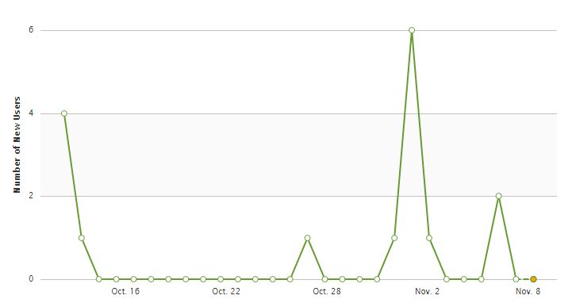
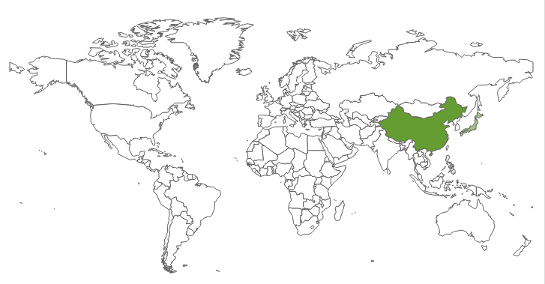
New Users - √

Slide 5
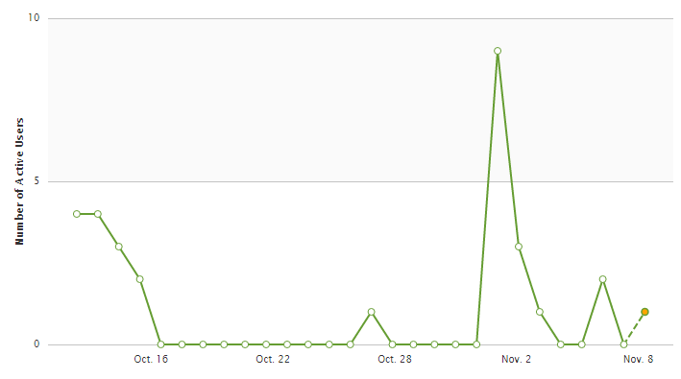
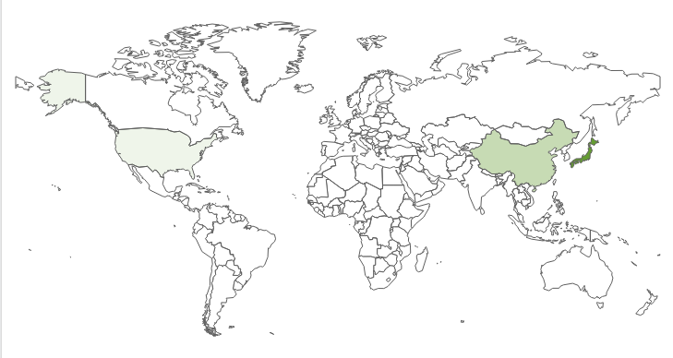
Active User - √

Slide 6
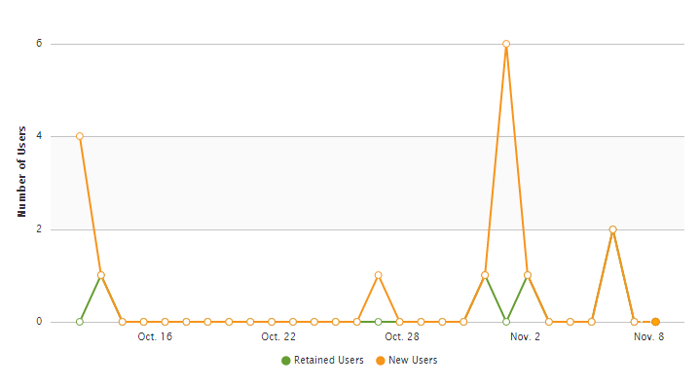
Retained User

Slide 7
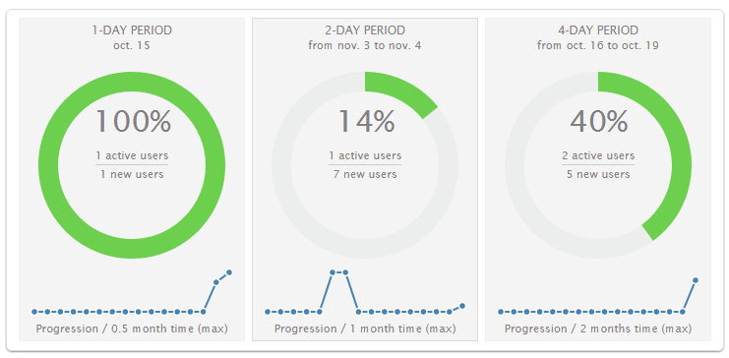
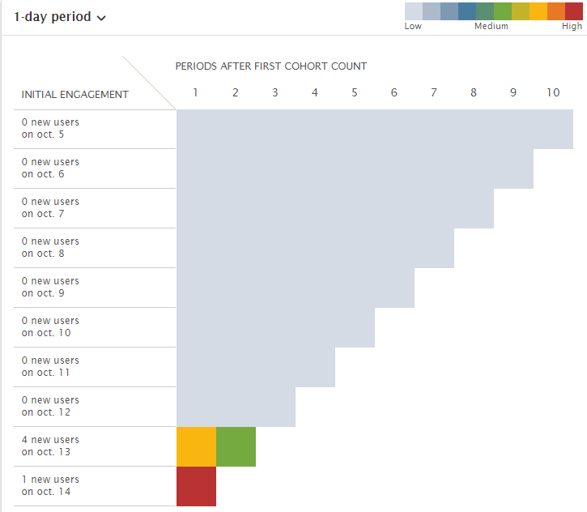
Retention – time region? Concept?

Slide 8
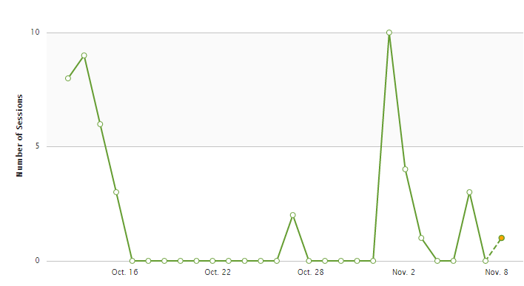
Session

Slide 9
手机端
Timeout activity

Slide 10
Issue

Slide 11
Used js api
Capptain.
Agent.
Start/end Activity
Pause (用哪个停止？)
Sendsessionevent
Sendevent
Start/end job
sessionTimeout

Slide 12
Questions - concept
Retained User ?
Tracking ? .url???
Retention Date?? Up-to-date???

Slide 13
Questions - accuracy
Active user (not showed)

Slide 14
Questions - api
Active User map : [city] api?

Slide 15
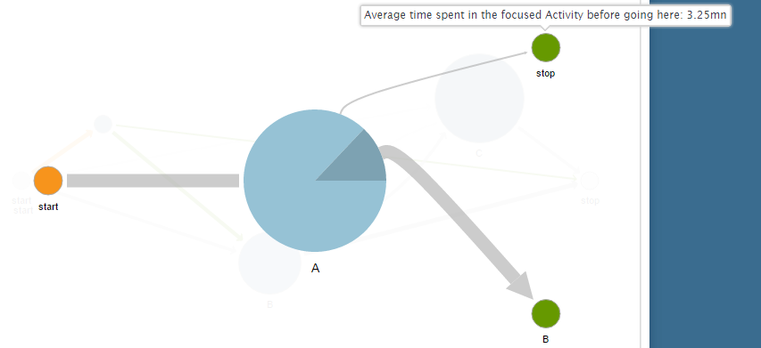
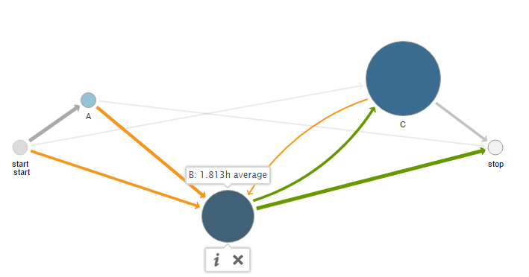

Slide 16
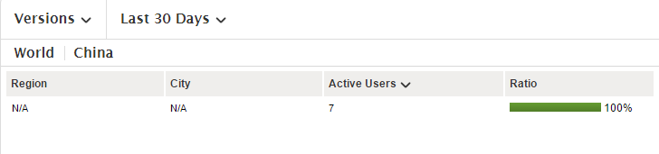
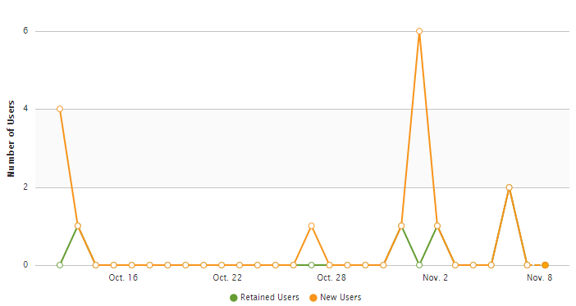

Slide 17
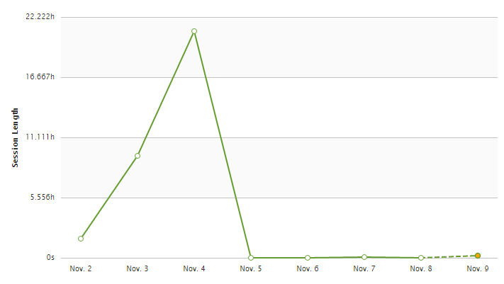
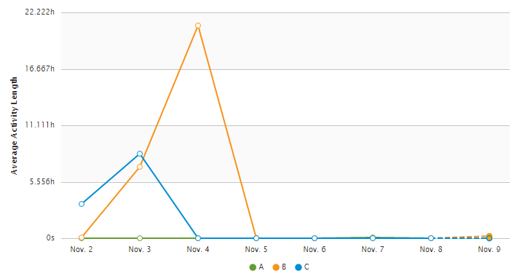

Slide 18
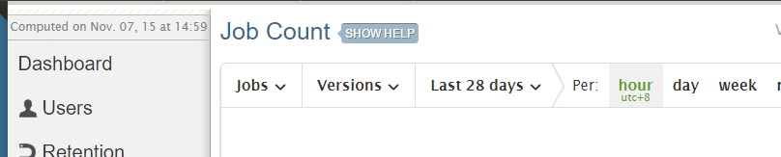
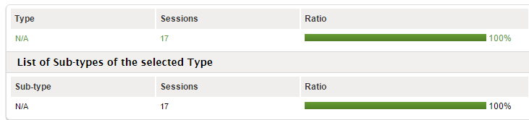

Slide 19
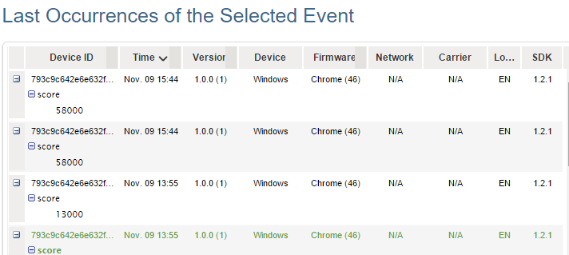
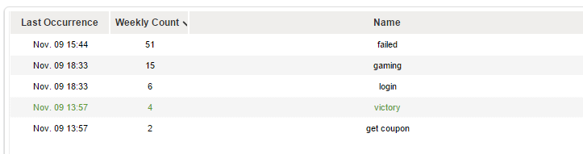
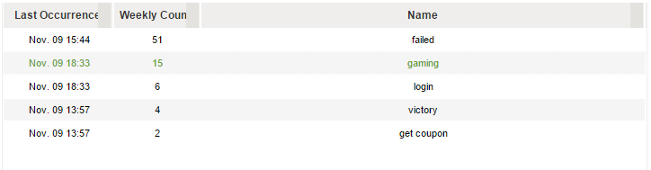

Slide 20
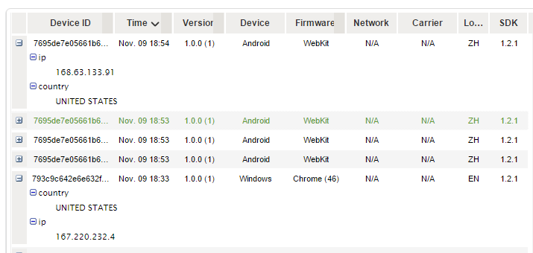

Slide 21
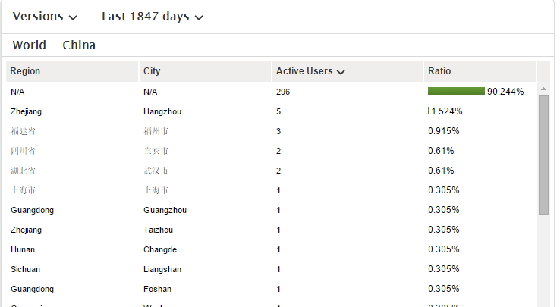

Slide 22
capptain.urls.getRegisterDeviceUrl=capptain.urls.getRegisterDeviceUrl||function(){return capptain.apiDomain+"/track/1/register"};capptain.urls.getXmppDiscoUrl=capptain.urls.getXmppDiscoUrl||function(){return capptain.apiDomain+"/xmpp-disco"};capptain.urls.getIpToCountryUrl=capptain.urls.getIpToCountryUrl||function(){return capptain.apiDomain+"/ip-to-country"};capptain.urls.getHttpBindUrl=capptain.urls.getHttpBindUrl||function(v){return"http://bosh."+v+"/http-bind"};

Slide 23
http://pv.sohu.com/cityjsons
http://lbs.amap.com/api/javascript-api/example/g/0703-2/

